Slide 1

Connecting loved ones across time zones
CSE 440, Autumn 2015
Quynh Huynh, Yunyi Song, Jingyi Lu, Yixun Zhang

Slide 2



Overall Problem
Why do people lose / keep a connection with someone?
How do we help them reconnect without feeling awkward?
Notes:
Even though we have many social media applications to stay connected, we lose touch with our loved ones when they move away because of the distance and time zone difference.

Slide 3
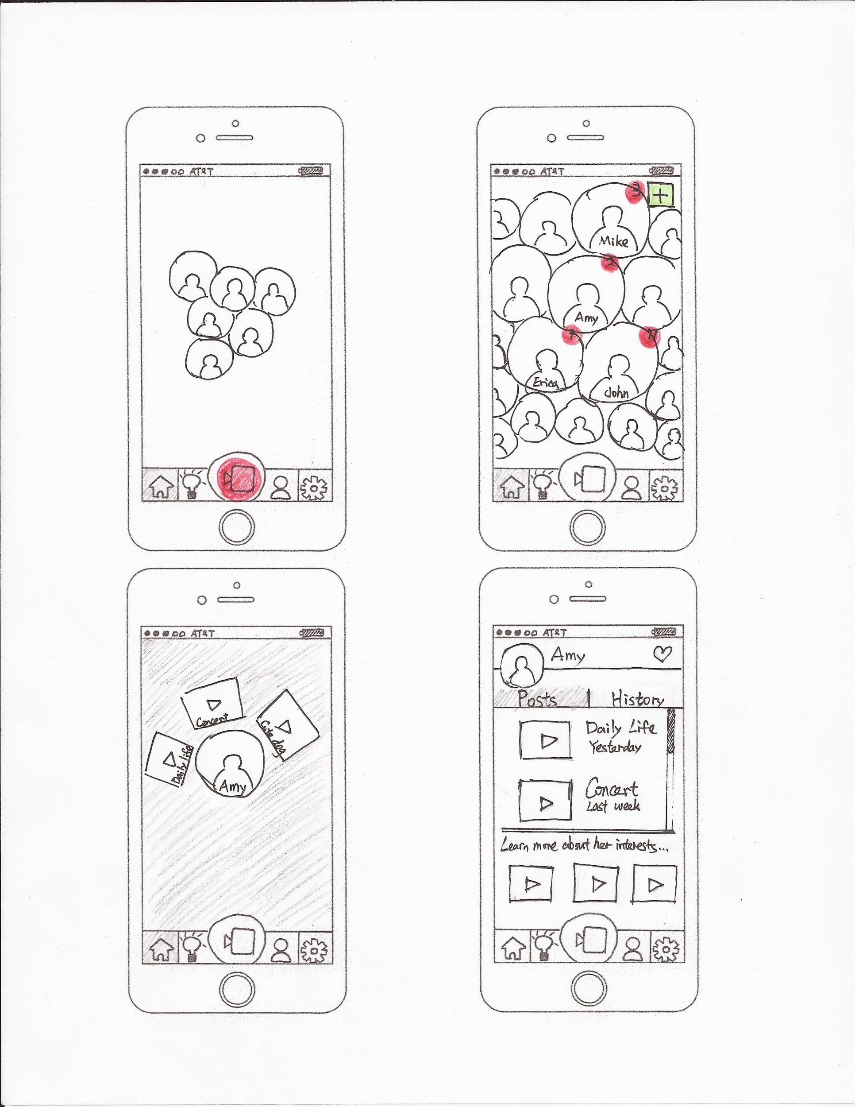
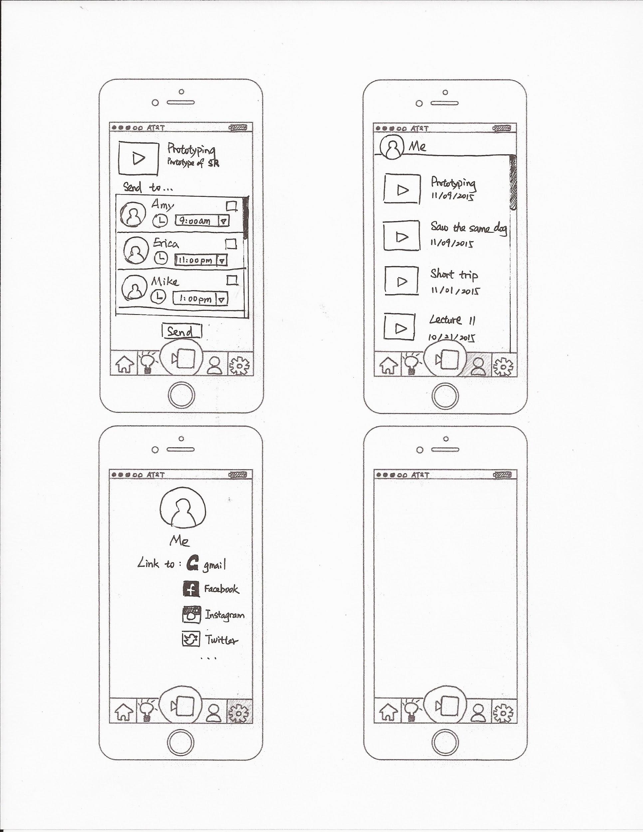
Initial Prototype
Notes:
Home page lists all user’s contacts with people user cares most at the center with notification (the red bubble) of their new posts.
User can link to other social medias so that it’ll automatically discover your contacts

Slide 4
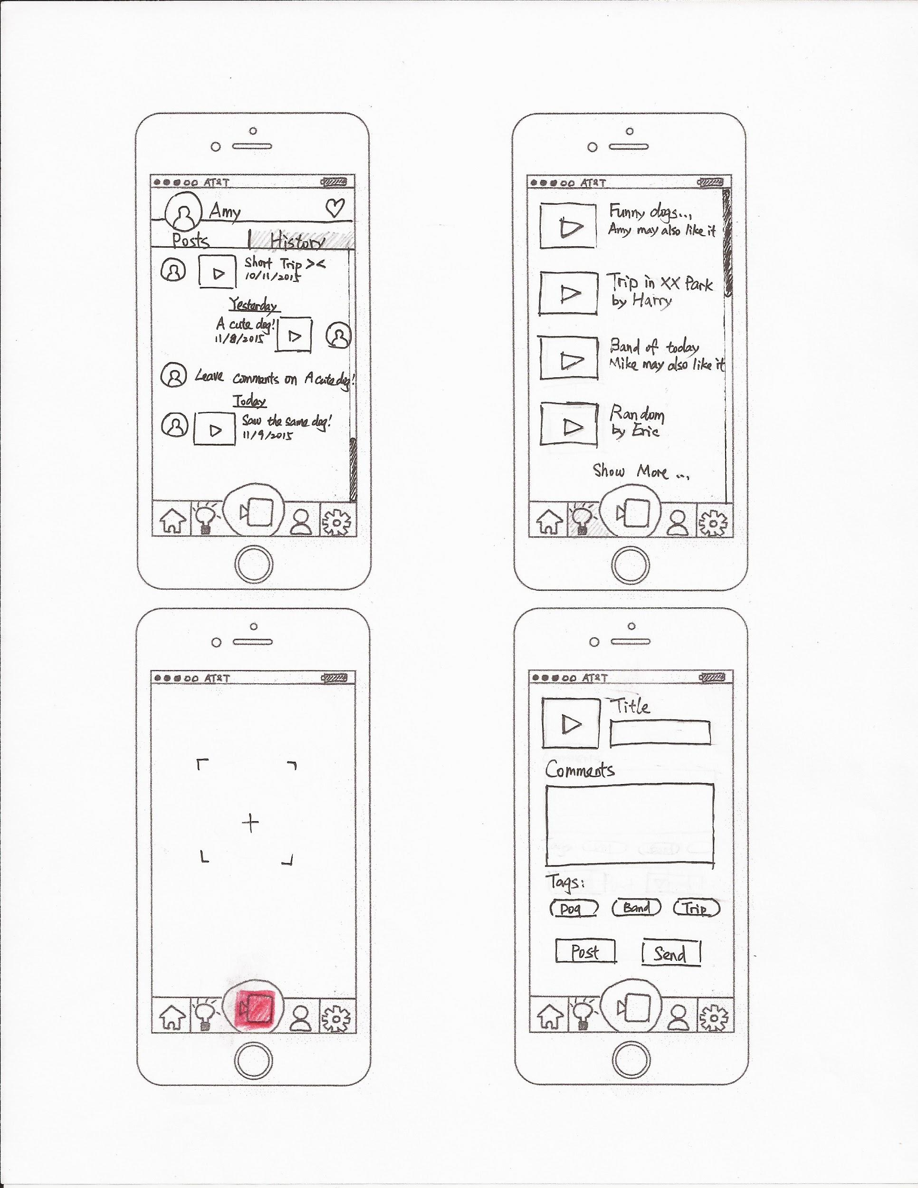
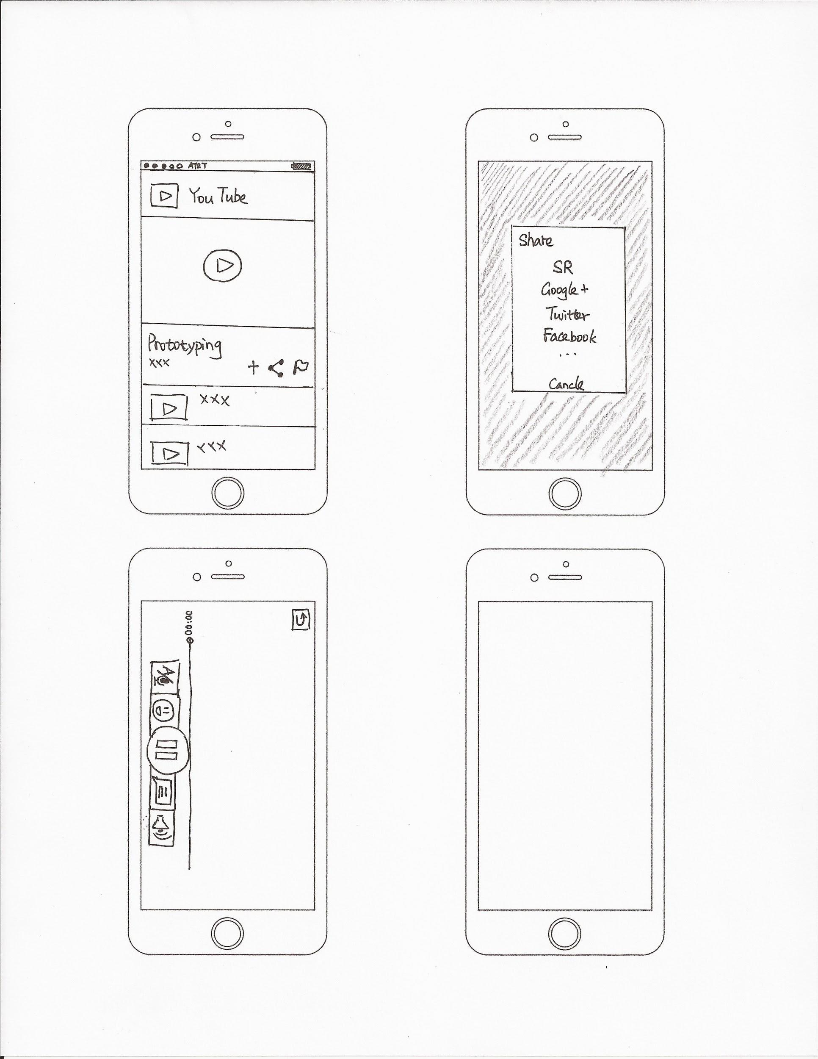
Initial Prototype
Task 1 - Maintaining a long-distance relationship
Notes:
Record short videos
Fill information and select tags
Schedule to send or send immediately
Recommend time to schedule based on users chatting history

Slide 5
Initial Prototype
Task 1 - Maintaining a long-distance relationship
Notes:
Add emoji or comments as commentary subtitles.
Record voice and will convert to text
Can switch between hearing voice comments or viewing text comments

Slide 6
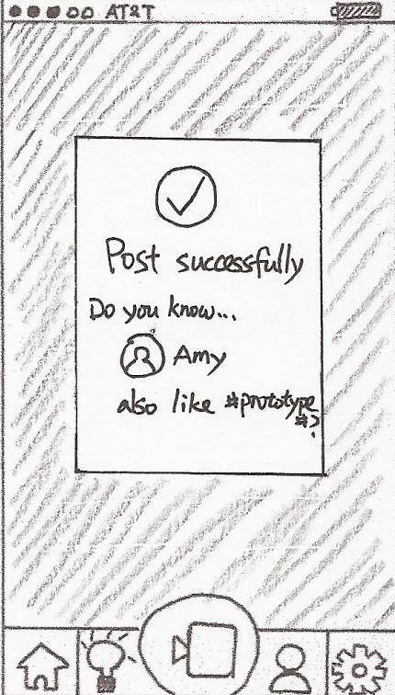
Initial Prototype
Task 2 - Easily start a conversation
Notes:
Can share videos from other platform
Will recommend contacts who may also like it

Slide 7
Initial Prototype
Task 2 - Easily start a conversation
Notes:
Recommend videos posted by user’s contacts which may interest user
And videos that user and contact both like

Slide 8
Initial Prototype
Task 2 - Easily start a conversation
Notes:
View contact posts
See more videos to learn contact’s recent interests

Slide 9
Heuristic Evaluation
Notes:
2 Heuristic Evaluation for 3 people
Explain our design and the idea behind to them
Let them give us feedbacks
Where we found most obvious problems

Slide 10
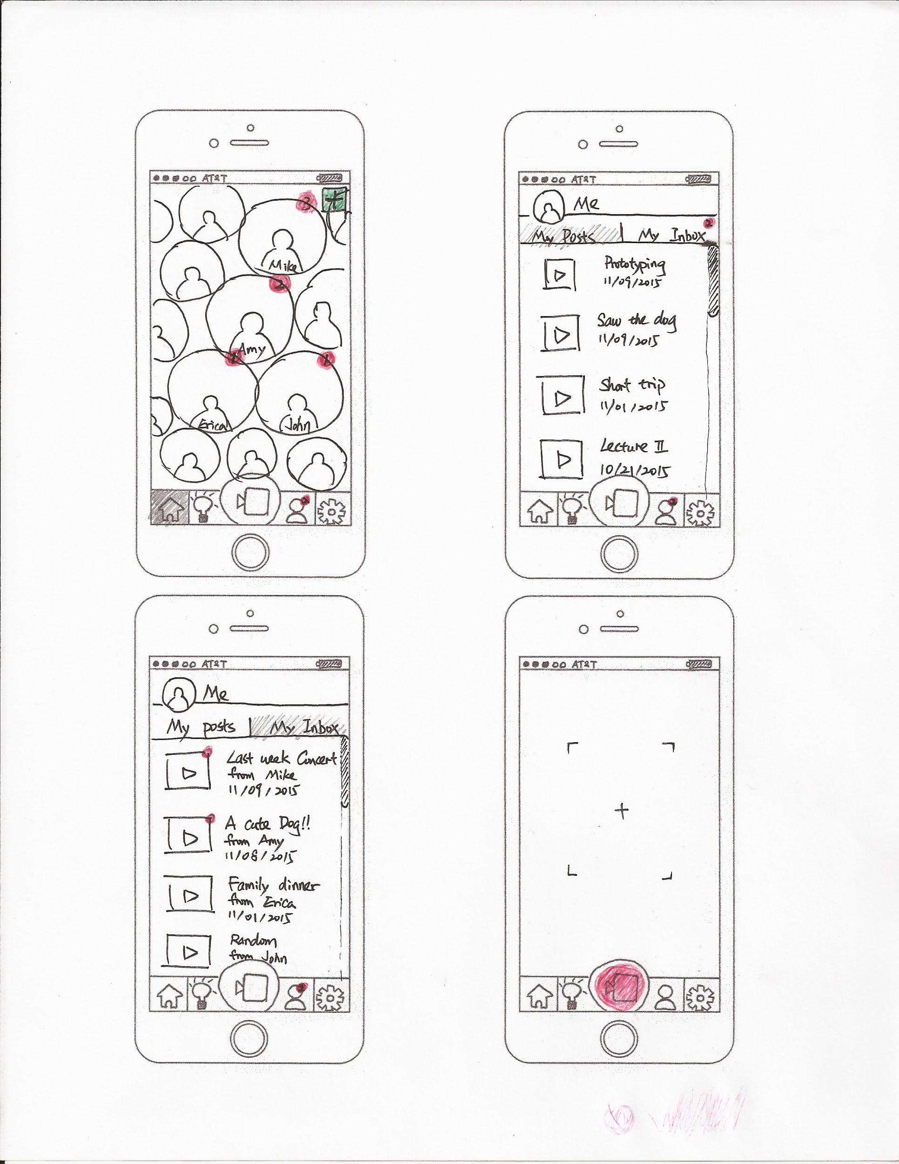
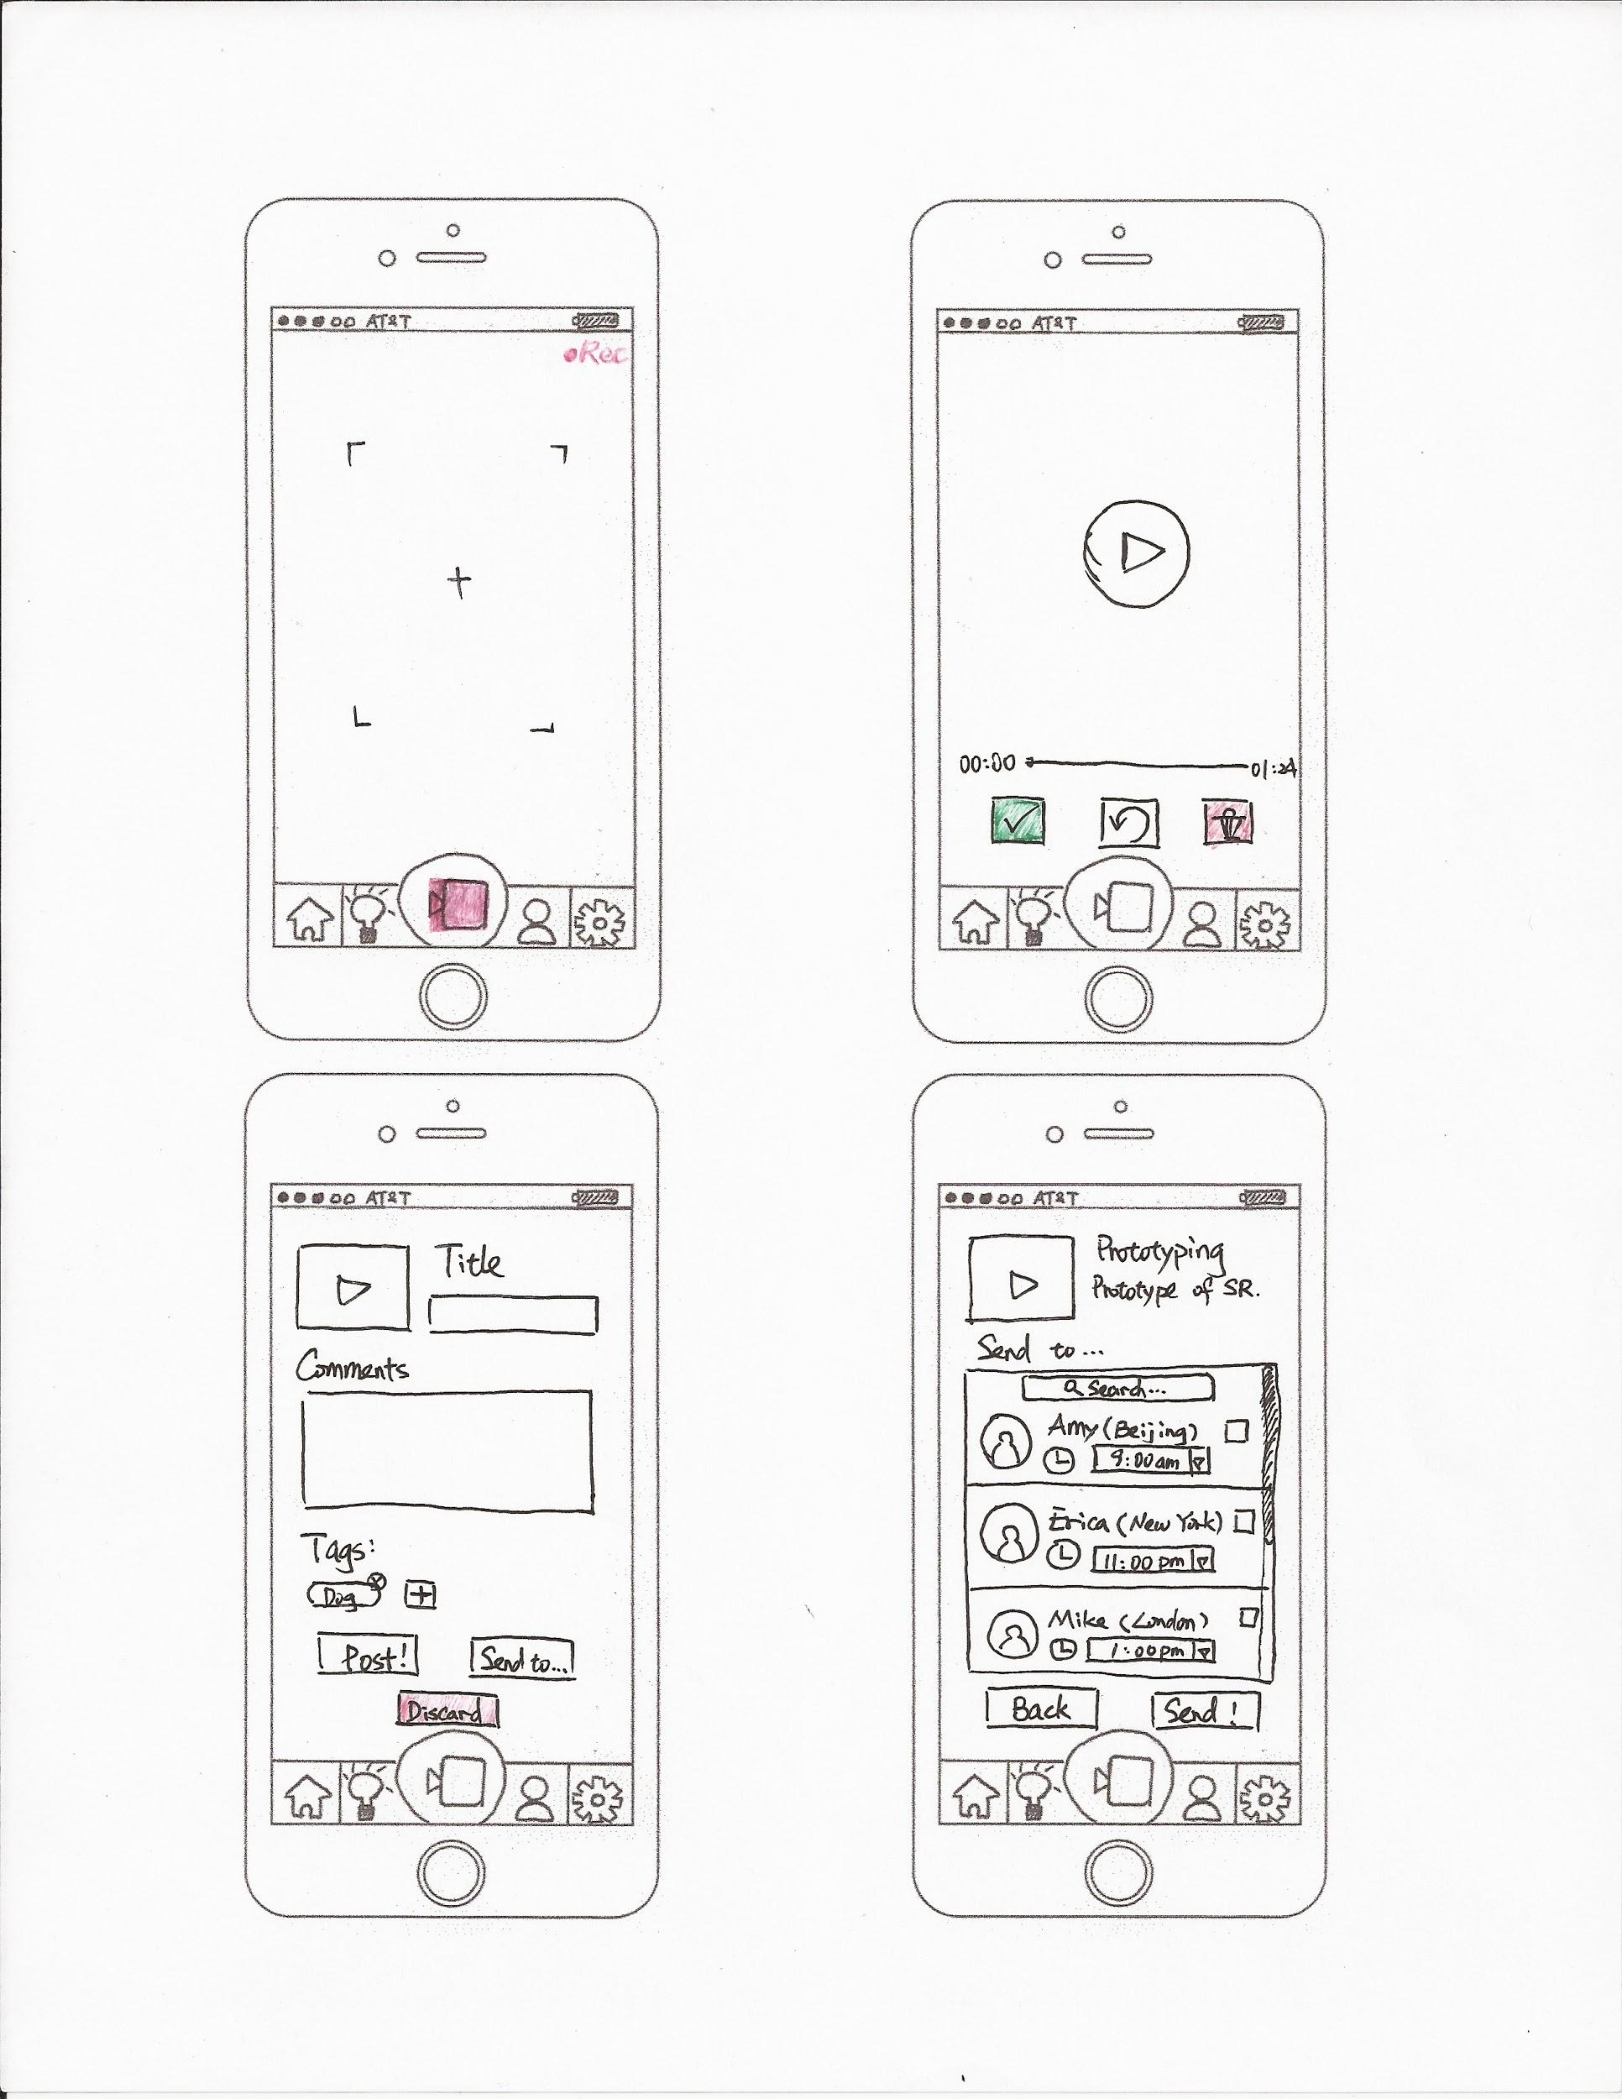
Heuristic Evaluation
More user control and freedom
Notes:
More flexibility to start recording
Flexibility to choose keep it or discard

Slide 11
Heuristic Evaluation
More user control and freedom
Before
After
Notes:
Flexibility to discard videos
Easier to create their own tags

Slide 12
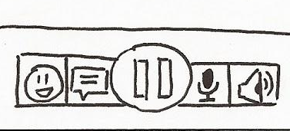
Heuristic Evaluation
More intuitive: recall instead of remember
Before
After
Before
After
Notes:
Make icons more intuitive

Slide 13
Heuristic Evaluation
More intuitive: recall instead of remember
Before
After
Before
After
Notes:
Make it clear what each button does and why it exists
And make delete/add tags more intuitive

Slide 14
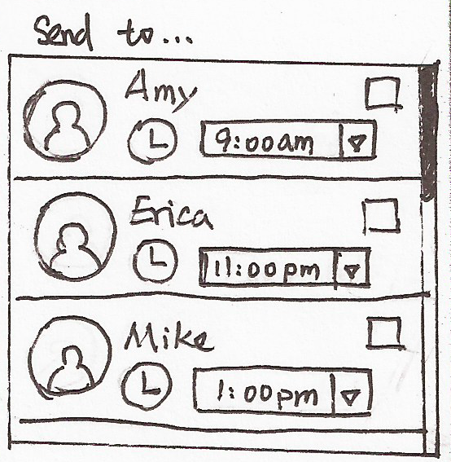
Heuristic Evaluation
More shortcuts: efficient to use
Before
After
Notes:
Make it easier for users to find a friend to send a video to

Slide 15
Heuristic Evaluation
More shortcuts: efficient to use
Before
After
Notes:
Add an inbox screen
Easier to find all newly received videos

Slide 16
Usability Tests
Notes:
A mock tutorial
Several tasks to test important or newly revised functionalities
Observe reactions & ask questions about their experience

Slide 17
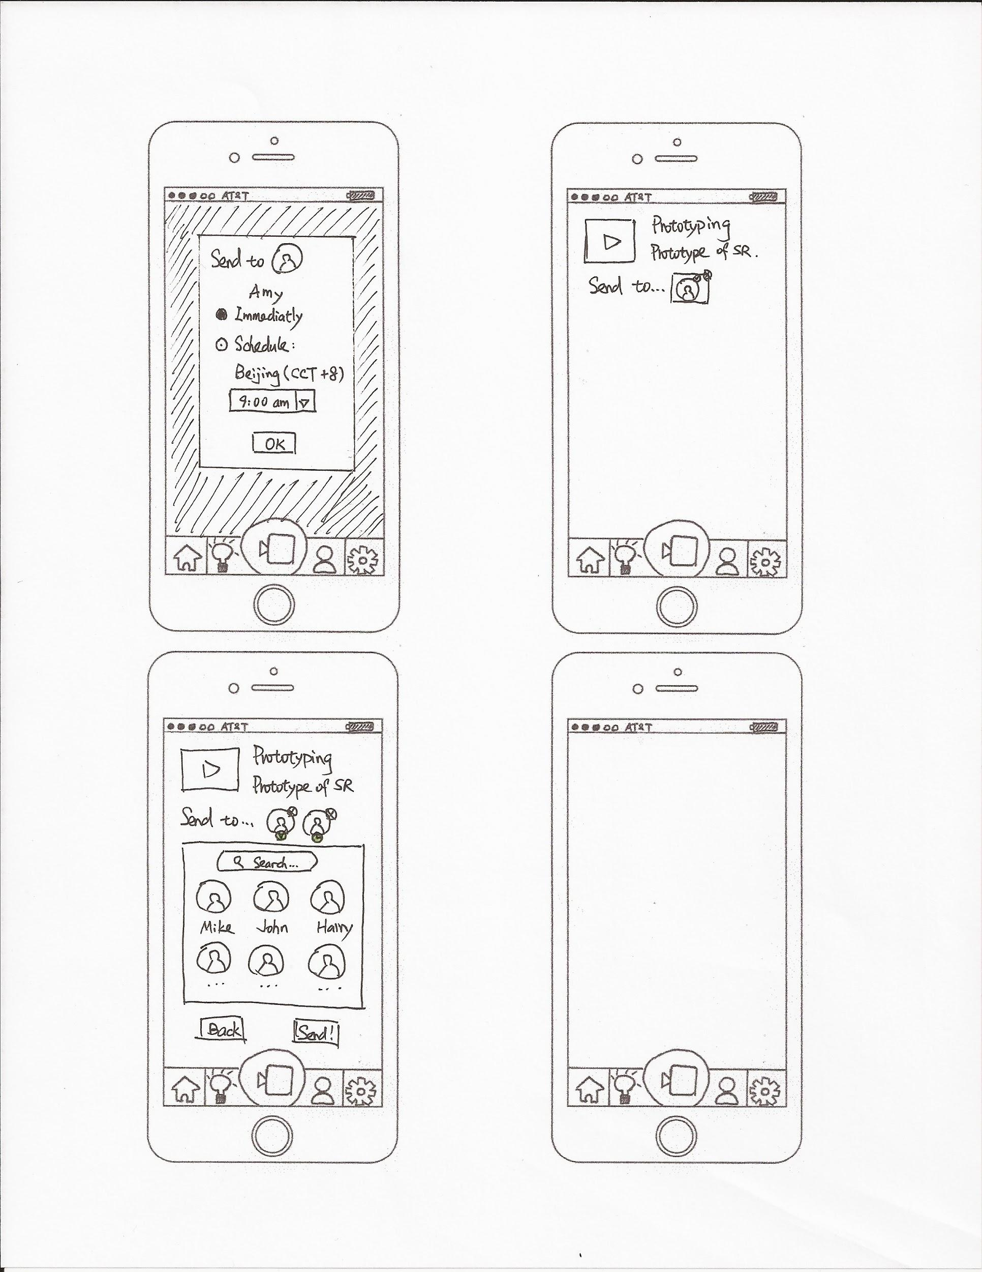
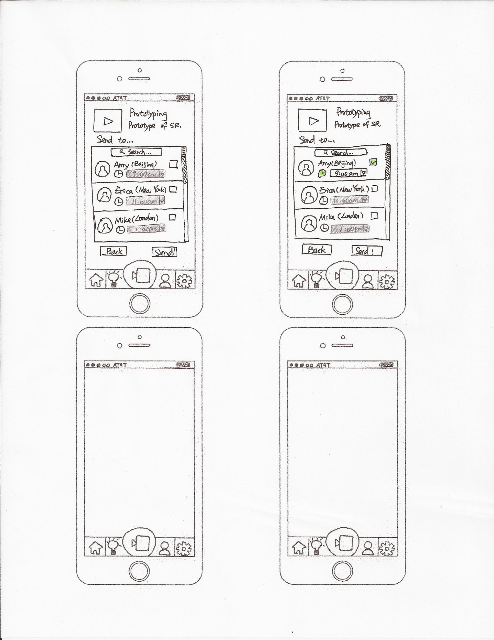
Usability Tests
Schedule when to send videos
Notes:
We had multiple iterations of the page that allows you to schedule when to send someone a video
Not sure if the time displayed is your time or their time
Also hard to find contact user want → added a search bar

Slide 18
Usability Tests
Schedule when to send videos
Notes:
Add city to make it clear
Not sure how to send videos immediately

Slide 19
Usability Tests
Schedule when to send videos
Notes:
Disable the dropdown selection of time when clock is not clicked on
But still confusing to some people what time zone it is and whether immediately or by schedule

Slide 20
Usability Tests
Schedule when to send videos
Notes:
Put immediately as an option to make it clear.
Have city above time selection to indicate it’s their contacts’ time

Slide 21
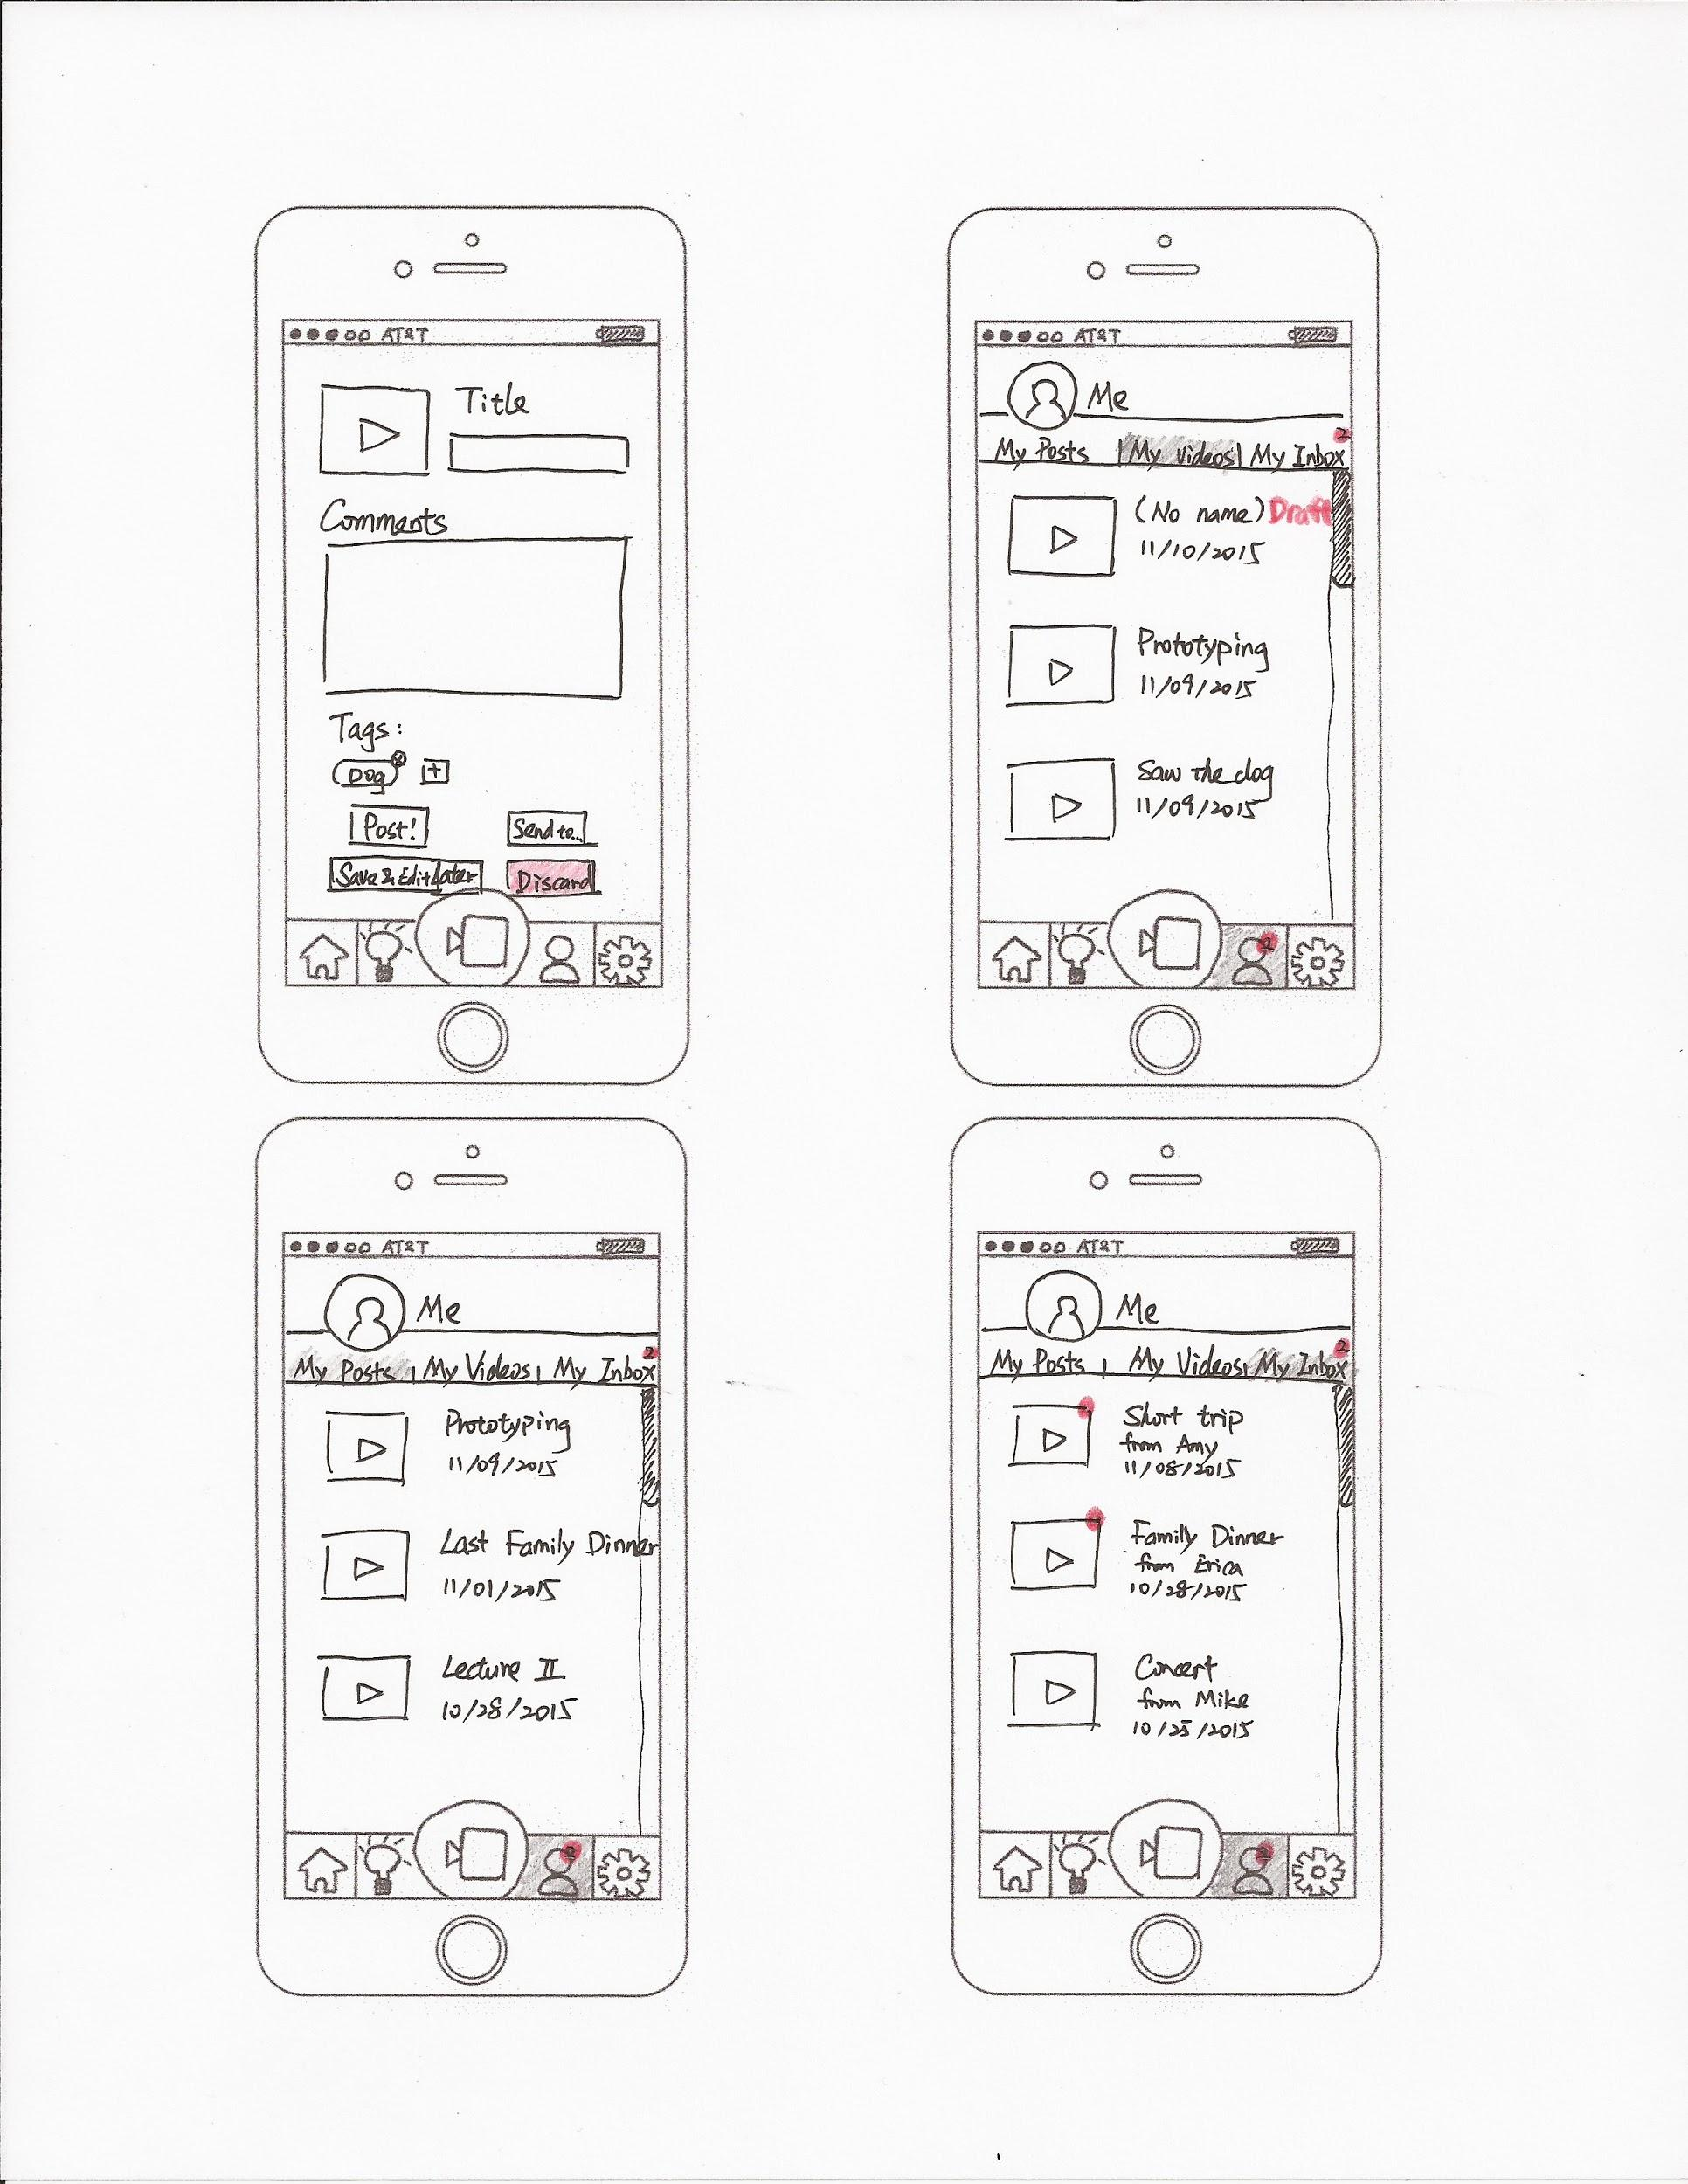
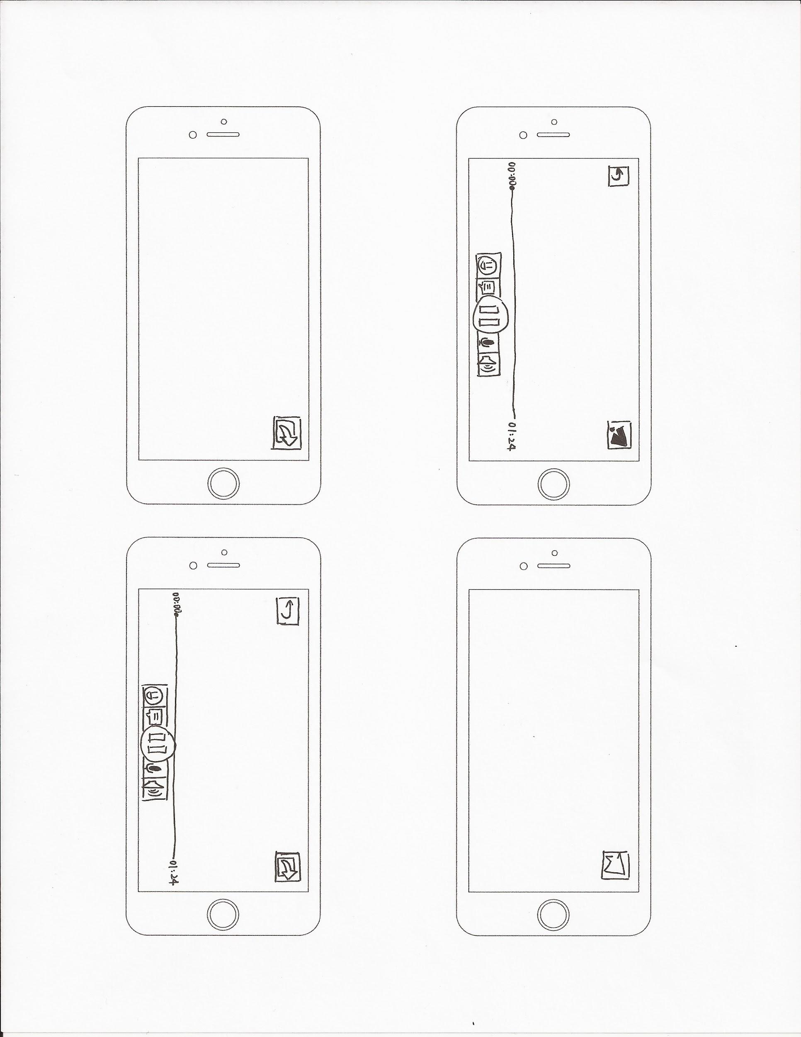
Usability Test
Save videos to post/send later
Notes:
Give users an option to save their work and refer to it later

Slide 22
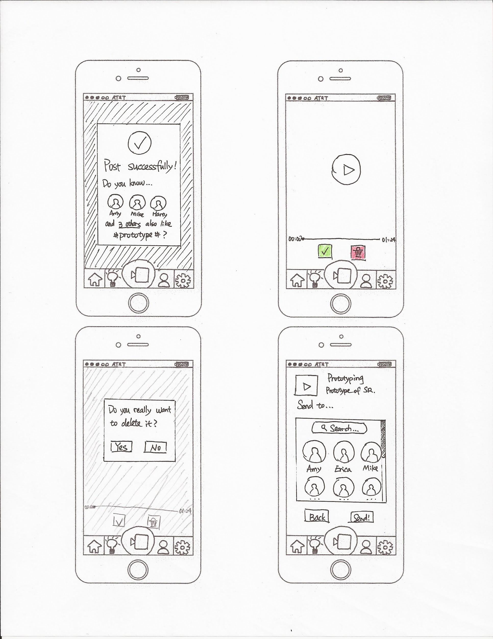
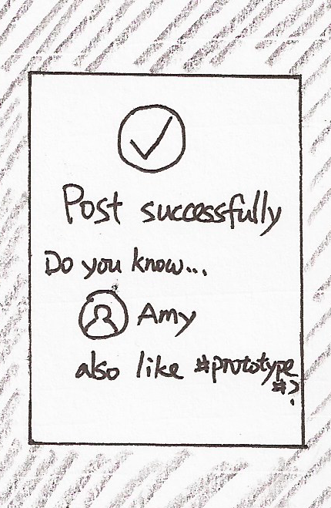
Usability Test
Before
After
Delete Confirmation
Posted Notification
Notes:
Prevent users from making mistakes
Give them more information about suggestions

Slide 23
Final Prototype
Notes:
Still use contacts as home page and can link to other social media

Slide 24
Final Prototype
Task 1 - Maintaining a long-distance relationship
Notes:
Record a short video
Send to several friends by schedule or immediately.

Slide 25
Final Prototype
Task 1 - Maintaining a long-distance relationship
Notes:
Can add emoji, leave text comments or voice comments that will be converted into text
Post/send shortcut

Slide 26
Final Prototype
Task 2 - Easily start a conversation
Notes:
Share videos and get contacts who may have common interests as you

Slide 27
Final Prototype
Task 2 - Easily start a conversation
Notes:
Discover contacts’ recent interests that you may not know

Slide 28
Final Prototype
Task 2 - Easily start a conversation
Notes:
Learn more about who you care about easily

Slide 29
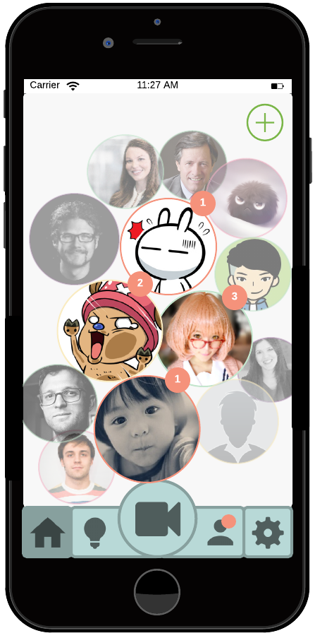
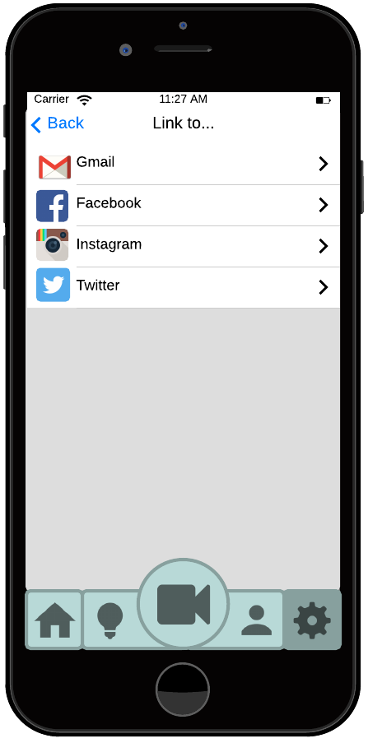
Digital Mockups
Notes:
Profile pictures to represent your contacts on home page
Link to other social media easily

Slide 30
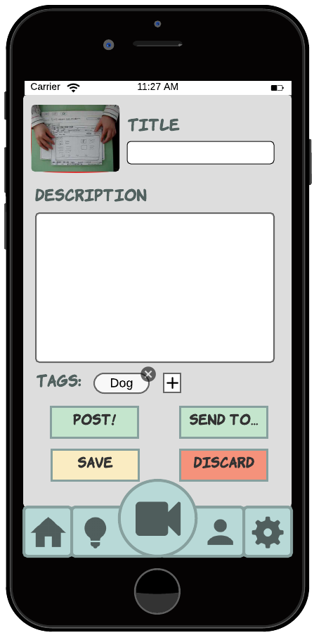
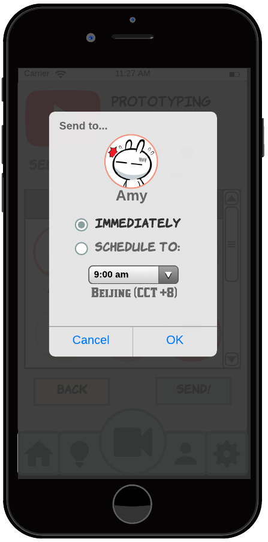
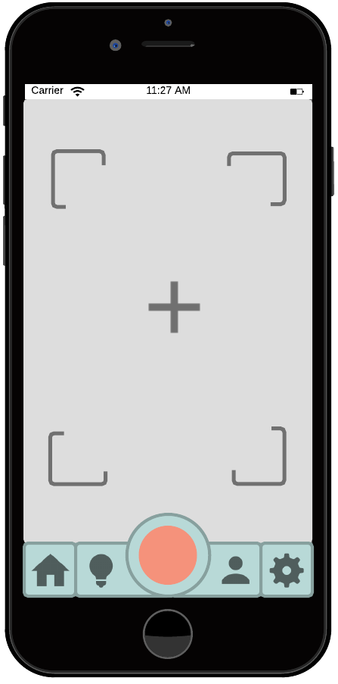
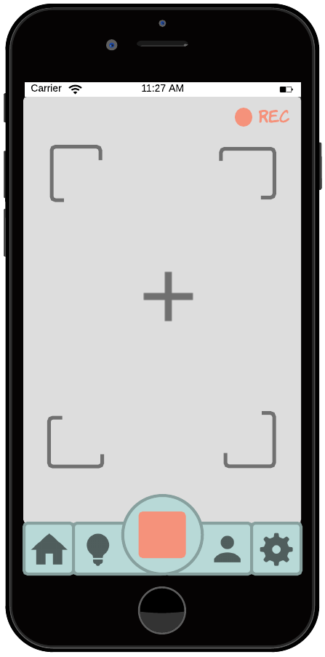
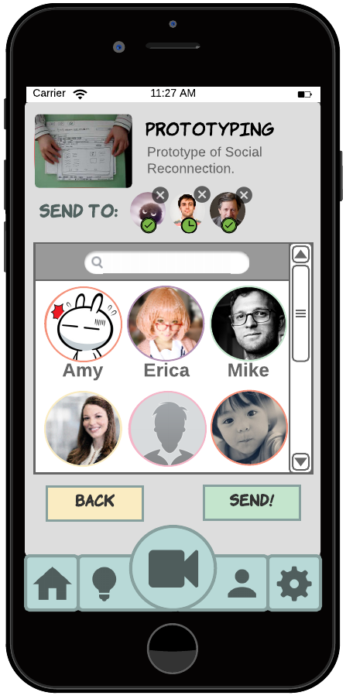
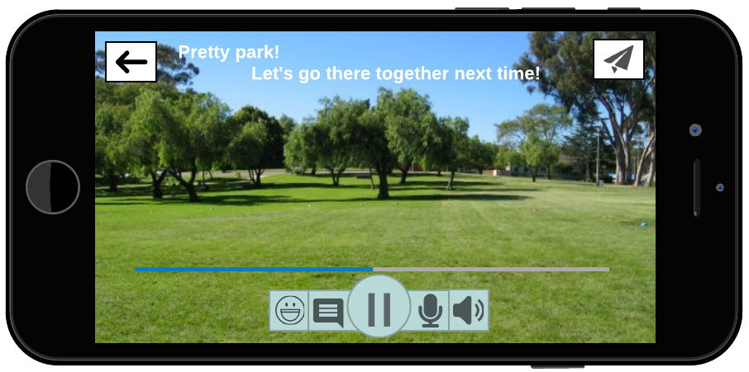
Digital Mockups
Task 1 - Maintaining long-distance relationship
Notes:
Record short videos
Send to your friends and let them receive it when they’re not busy by scheduling

Slide 31
Digital Mockups
Task 1 - Maintaining long-distance relationship
Notes:
Various and efficient way to leave comments

Slide 32
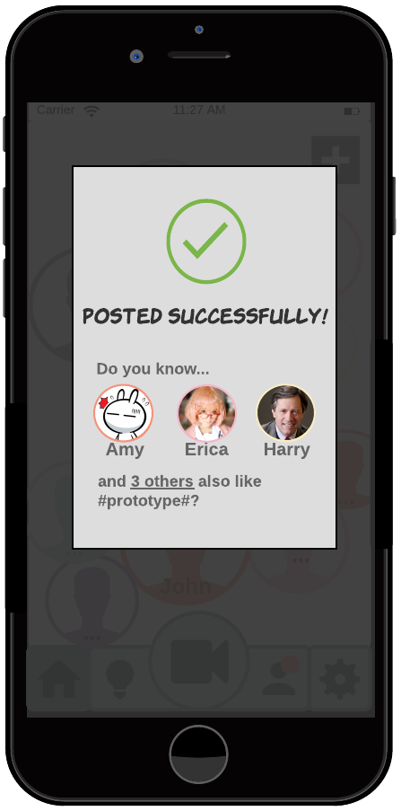
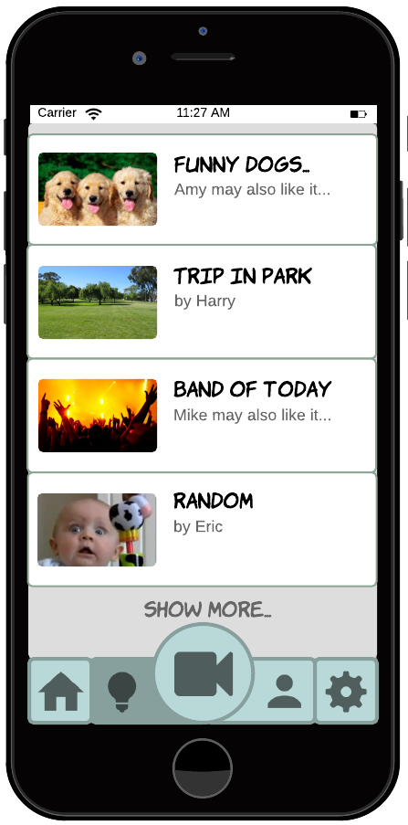
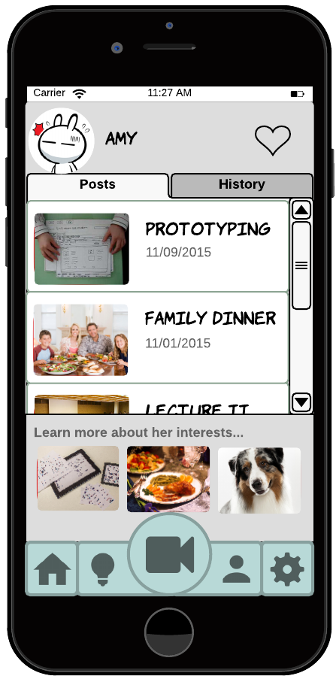
Digital Mockups
Task 2 - Easily start a conversation
Notes:
Share videos from other platform
Learn who may have same interests easily

Slide 33
Digital Mockups
Task 2 - Easily start a conversation
Notes:
Discover common interests with friends and have something to share with close friends

Slide 34
Digital Mockups
Task 2 - Easily start a conversation
Notes:
Easy to learn more about their recent interests

Slide 35
What We Learned This Quarter
More research + more sketching → better prototypes
Test early and test often
Every detail in design matters, otherwise you have confused users
Focus on your tasks!
Teamwork time is very precious – use it effectively!

Slide 36
That’s All Folks!
Thank you! Questions?

